Slide 1
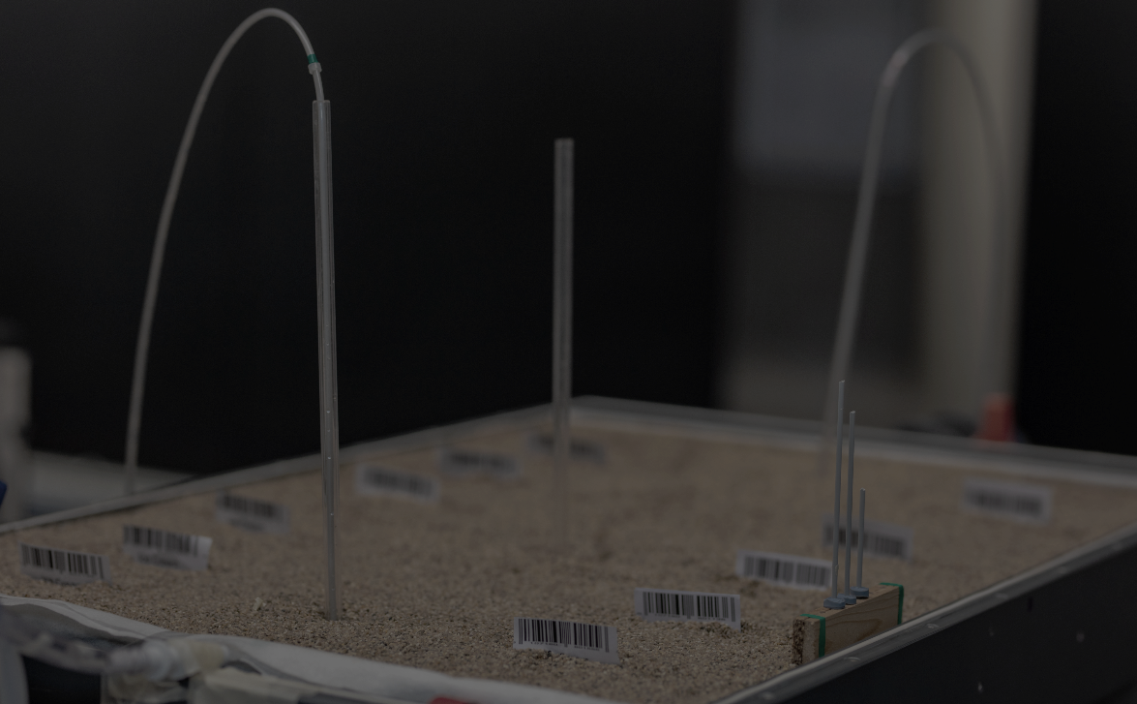
^{Poster session 8,} ^{3rd June 2021}
Use of DNA tracers for determining aquifer hydraulic properties in a 3-dimensional laboratory sand tank
Swagatam Chakraborty¹, Rayan Hamza Mohamed Elhaj², Chamath Arachchilage² , Jan Willem Foppen^{2,3}, Thom Bogaard³, and Jack Schijven⁴
Swagatam Chakraborty
PhD student
Faculty of Geosciences
s.chakraborty@uu.nl
https://www.tudelft.nl/citg/onderzoek/stories-of-science/water-met-een-streepjescode

Slide 2
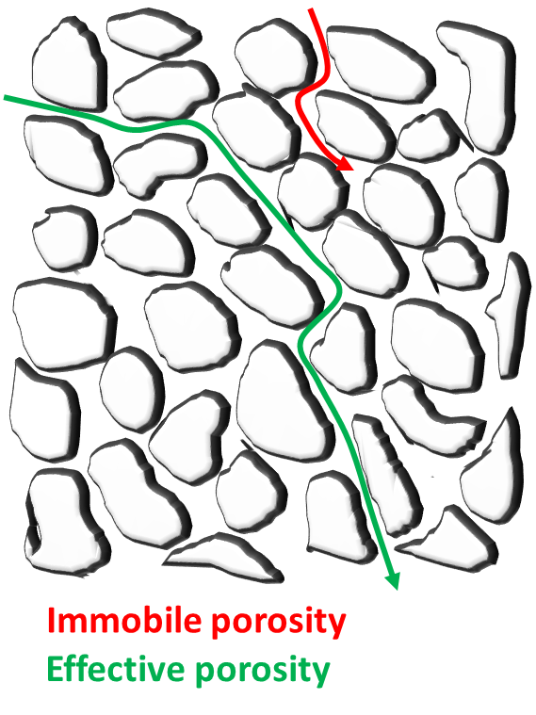
Introduction and objectives
Groundwater tracers
Groundwater tracers are used for groundwater flow path determination, groundwater velocity, residence time, aquifer physical and chemical characterization
Traditional groundwater tracers (NaCl, dyes etc.) suffers from
lack of distinctiveness
inability of multi-point, multi-plexed tracing
background noise
We investigate recently developed DNA tracers as a potential alternative for groundwater and contaminant tracing. Precisely, here we present preliminary results oriented towards the objectives -
Potential of DNA microparticle tracers in determining porous media hydraulic parameters (hydraulic conductivity [K], effective porosity [n_{e}])
Comparison of three dimensional transport behaviour of DNA microparticle tracers with traditional conservative tracers
Figure 1: Effective porosity

Slide 3
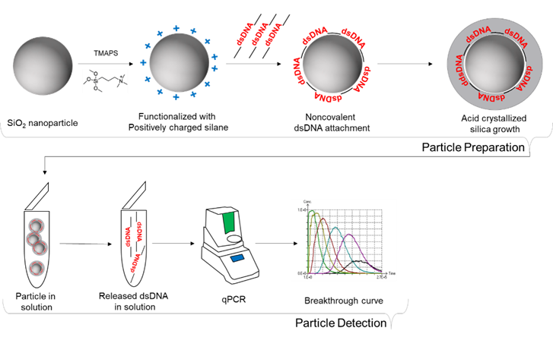
DNA tracers
Make:
Silica or magnetite core
Double stranded DNA
Protective silica covering
Properties
Spherical
ca.200-300 nm
Zeta potential -50mV (in phosphate buffer)
Quantification
Quantitative polymerase chain reaction (qPCR)
Advantages
Low detection limit
No natural prevalence
Ideally unlimited number of distinct tracers
High specificity
Multi-point, multi-plexed tracing
Figure 2: DNA tracers and quantification

Slide 4
Objectives
Potential of DNA tracers to characterise hydraulic conductivity and effective porosity of saturate porous medium
Comparison of three dimensional transport behaviour of DNA tracers and traditional conservative tracers (NaCl, fluorescein)

Slide 5
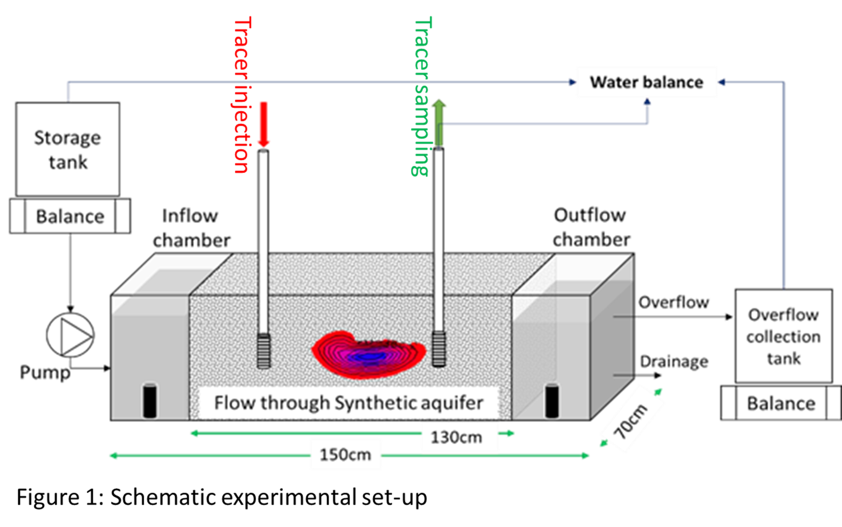
Experimental set up
3-dimensional synthetic aquifer
Dimension: 1.5m x 0.7m x 0.4m
Sand: 1200-1500µm
Continuous and automatic monitoring of water input and output
Figure 3: Schematic experimental set up

Slide 6
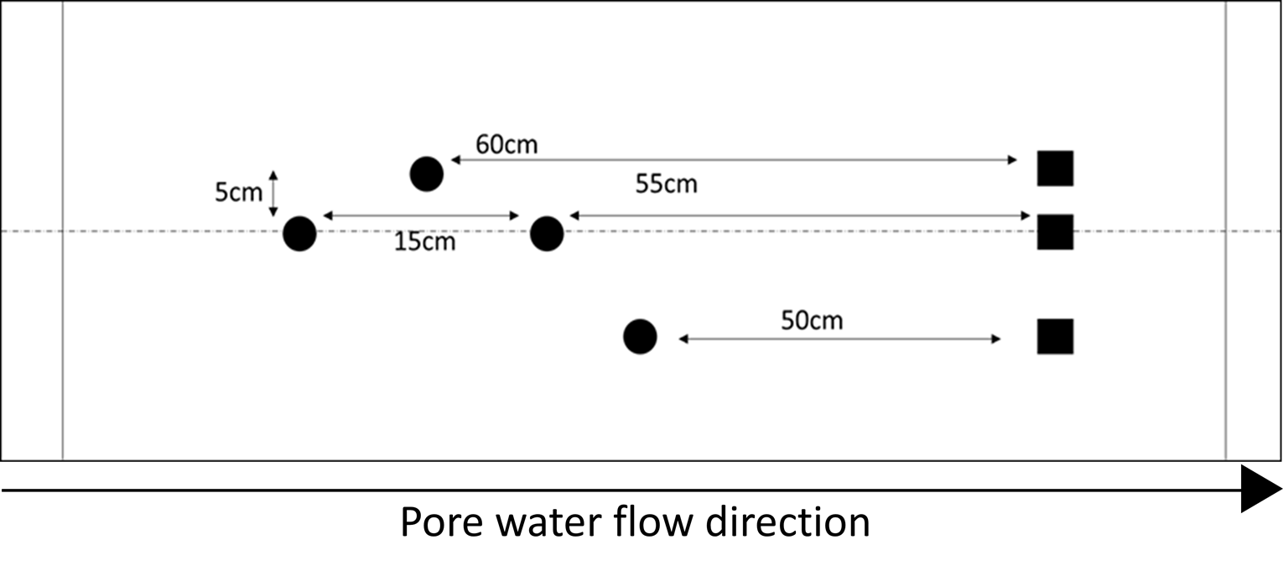
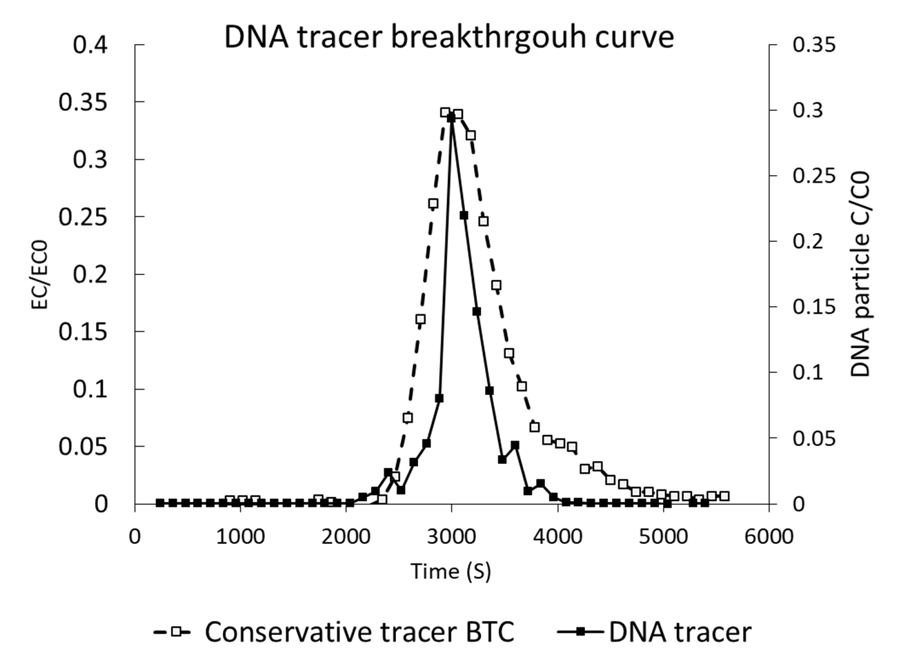
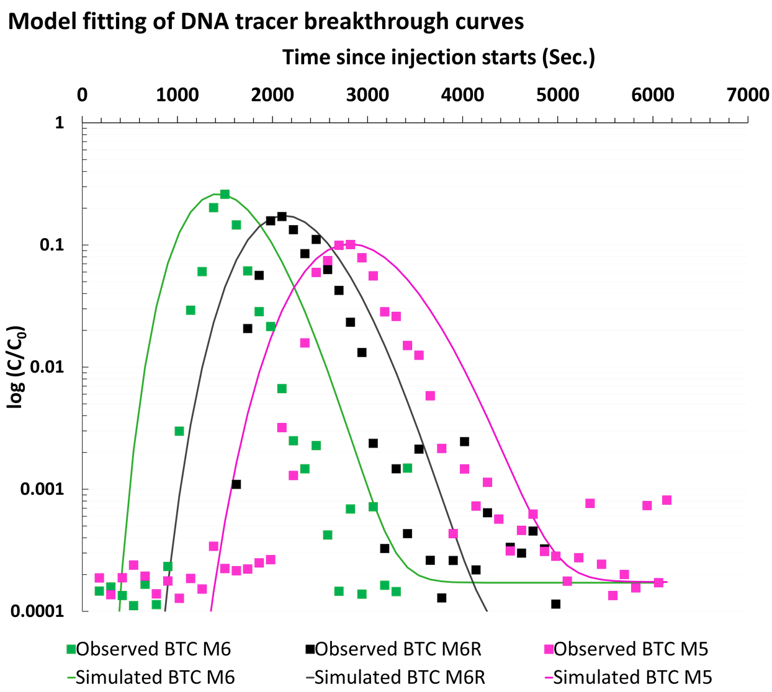
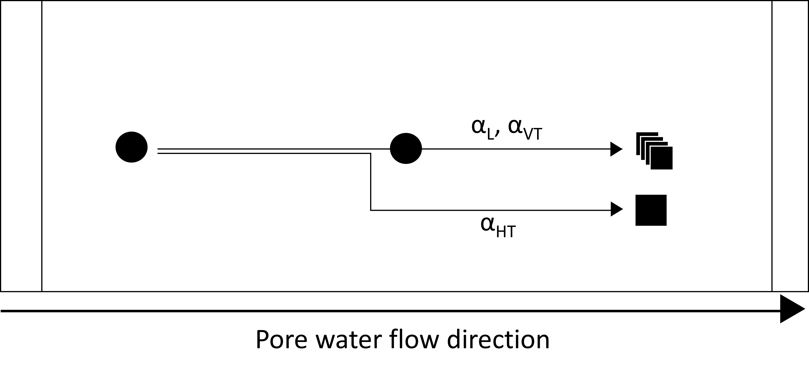
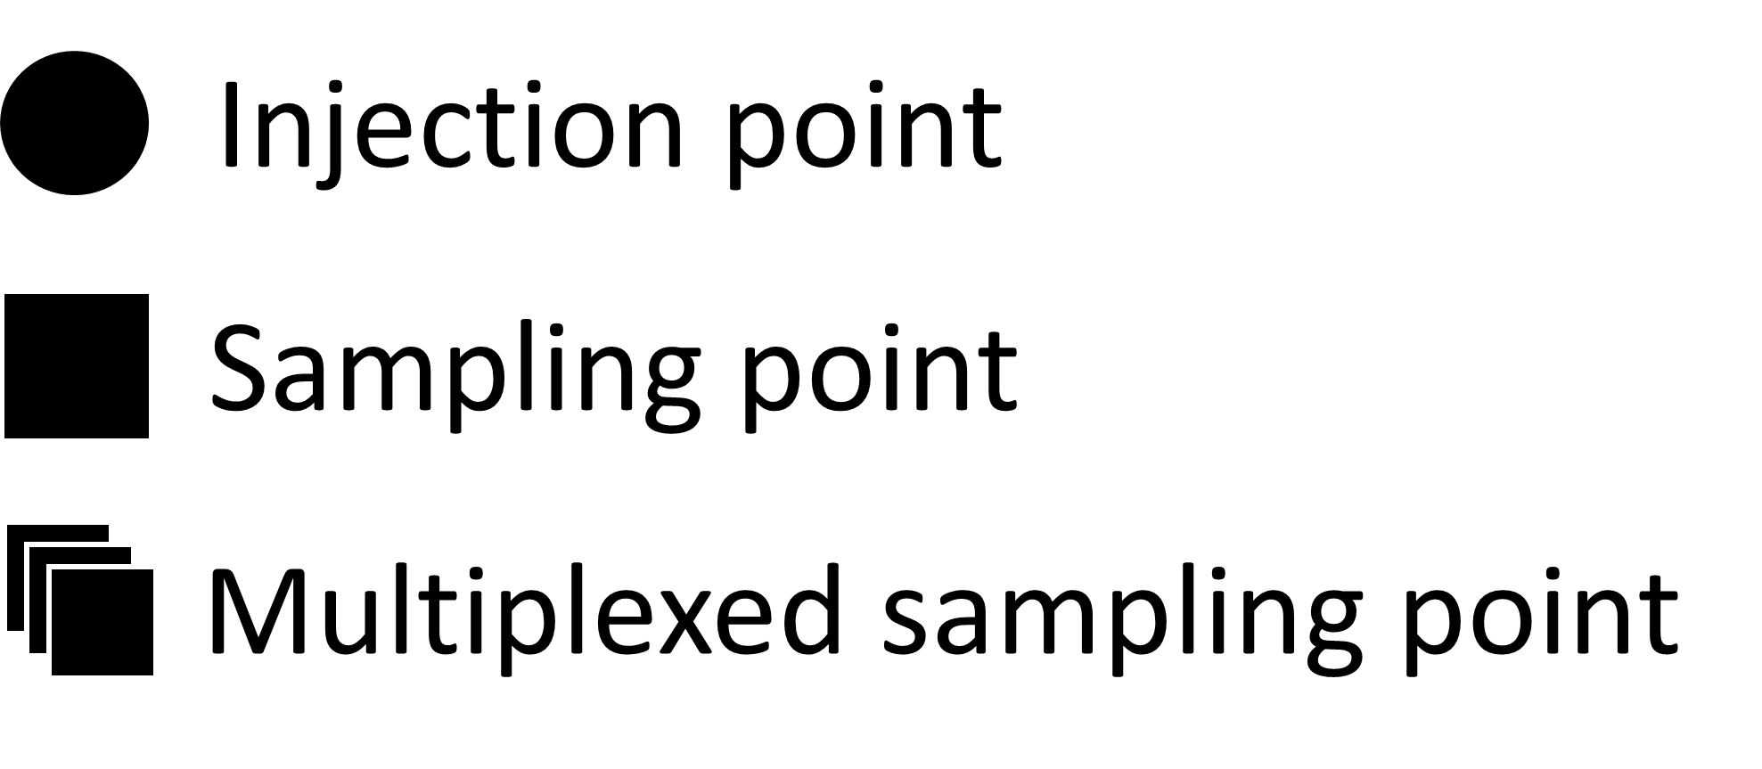
Overall methodology
Tracer transport experiments typically produces breakthrough curves (time concentration curves)
The DNA concentrations are expressed in terms of relative effluent concentrations
The time-concentration curves are subjected to 3D groundwater and solute transport modeling for fitting to obtain hydraulic parameters of interest [MODFLOW, MT3DMS]
Different configurations on injection and sampling points distributed horizontally and vertically throughout the porous medium

Slide 7
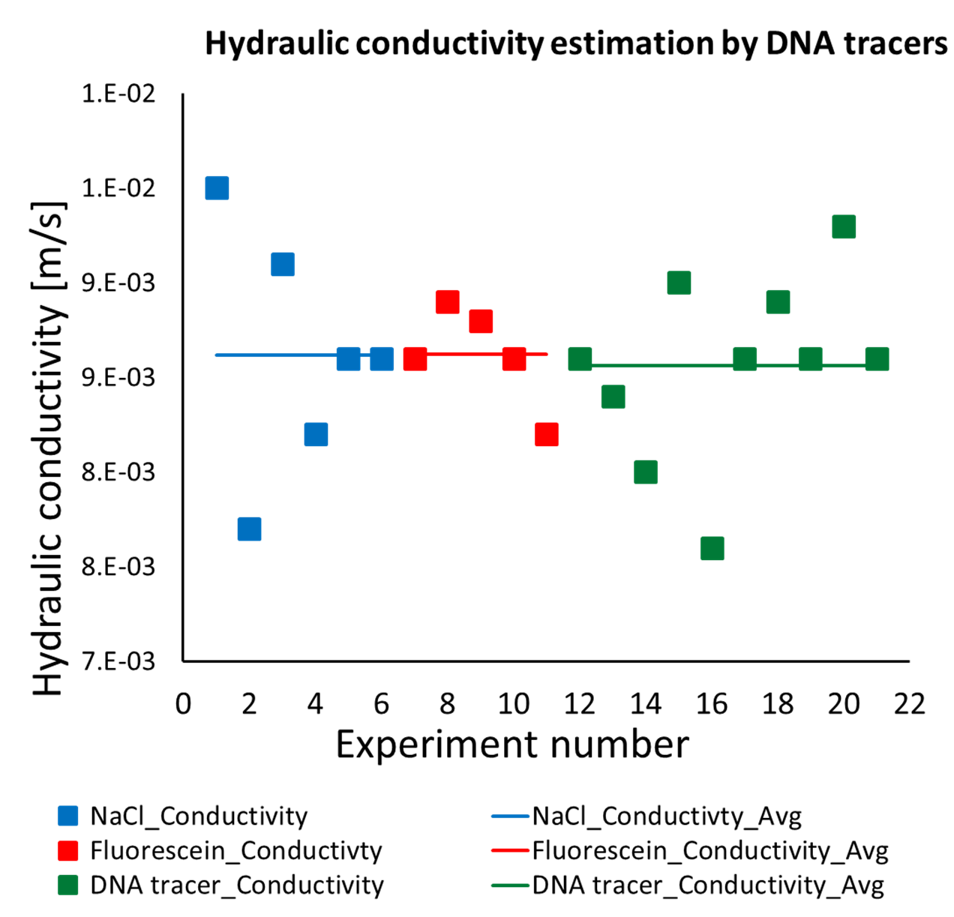
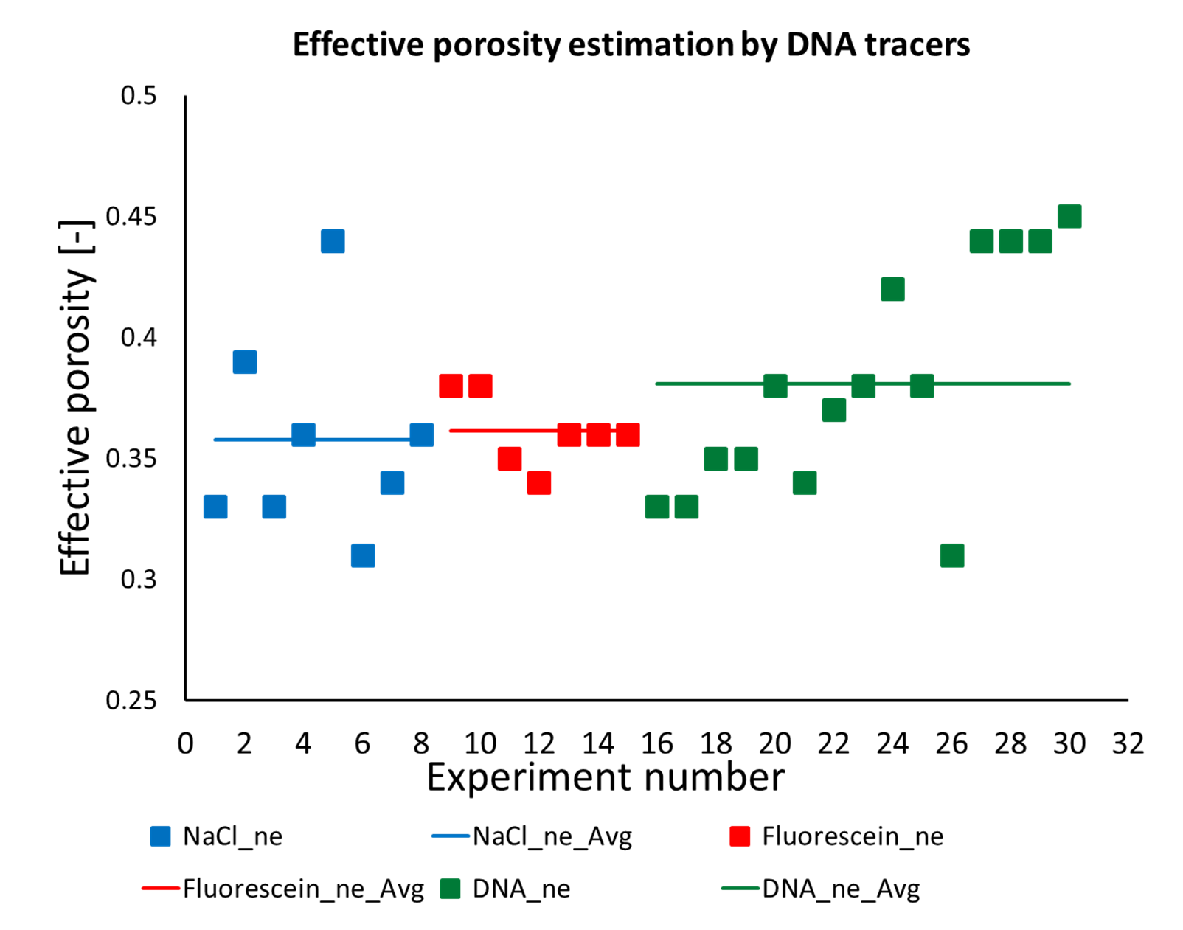
Key results
Figure 4: Comparing hydraulic conductivity (left) and effective porosity (right) estimations obtained from conservative (NaCl, Fluorescein) and DNA tracers

Slide 8
Key results
 | Hydraulic conductivity [m/s] |  | Effective porosity [-]
Tracers | Average | Stdev | Average | Stdev
NaCl | 8.6E-03 | 6.4E-04 | 0.36 | 0.04
Fluorescein | 8.6E-03 | 2.7E-04 | 0.36 | 0.01
DNA tracers | 8.6E-03 | 4.9E-04 | 0.38 | 0.05
Table 1: Comparing hydraulic conductivity and effective porosity values obtained from DNA and conservative tracer transport experiments
Hydraulic conductivity and effective porosity values and parameter value spaces obtained from DNA tracers are comparable to that conservative tracers
DNA transport behaviour in the transverse direction (horizontally perpendicular to the flow line) differs from that of conservative tracers

Slide 9
Conclusion
Hydraulic conductivity and effective porosity estimations, two of the most important aquifer hydraulic properties, are in good agreement between DNA tracers and conservative tracers
However, transport behaviour of the DNA tracers in the transverse direction, perpendicular to the primary groundwater flow line, is different from that of conservative tracers
DNA tracers have the potential to be used as groundwater tracers, as far as determining permeability and effective porosity of the aquifer is concerned

Slide 10
Conclusion
Hydraulic conductivity and effective porosity estimations, two of the most important aquifer hydraulic properties, are in good agreement between DNA tracers and conservative tracers
However, transport behaviour of the DNA tracers in the transverse direction, perpendicular to the primary groundwater flow line, is different from that of conservative tracers
DNA tracers have the potential to be used as groundwater tracers, as far as determining permeability and effective porosity of the aquifer is concerned
Limitation
Interaction with aquifer sediment (deposition, attachment)
Transport behaviour in perpendicular to flow line directions

Slide 11
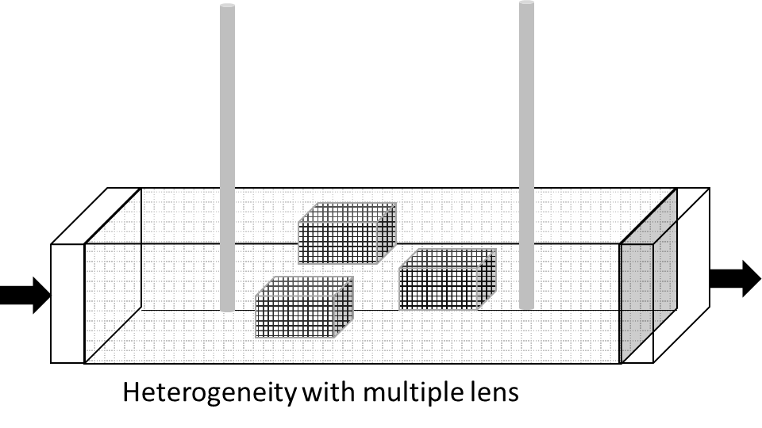
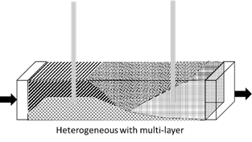
Further work
Ability of DNA colloidal tracers to determine horizontal transvers and vertical transverse dispersion
Potential of DNA tracer particles to identify and characterize physical heterogeneity in the aquifer domains
Figure 5: Example of porous media physical heterogeneity
References
Foppen, J. W., Orup, C., Adell, R., Poulalion, V., & Uhlenbrook, S. (2011). Using multiple artificial DNA tracers in hydrology. Hydrological Processes, 25(19), 3101-3106. doi:10.1002/hyp.8159
Mikutis, G., Deuber, C. A., Schmid, L., Kittilä, A., Lobsiger, N., Puddu, M., Stark, W. J. (2018). Silica-Encapsulated DNA-Based Tracers for Aquifer Characterization. Environmental Science & Technology, 52(21), 12142-12152.
Kong, X.-Z., Deuber, C. A., Kittilä, A., Somogyvári, M., Mikutis, G., Bayer, P., Wendelin, S., Saar, M. O. (2018). Tomographic reservoir imaging with DNA-labeled silica nanotracers: The first field validation. Environmental Science & Technology, 52(23), 13681-13689.

