Slide 1
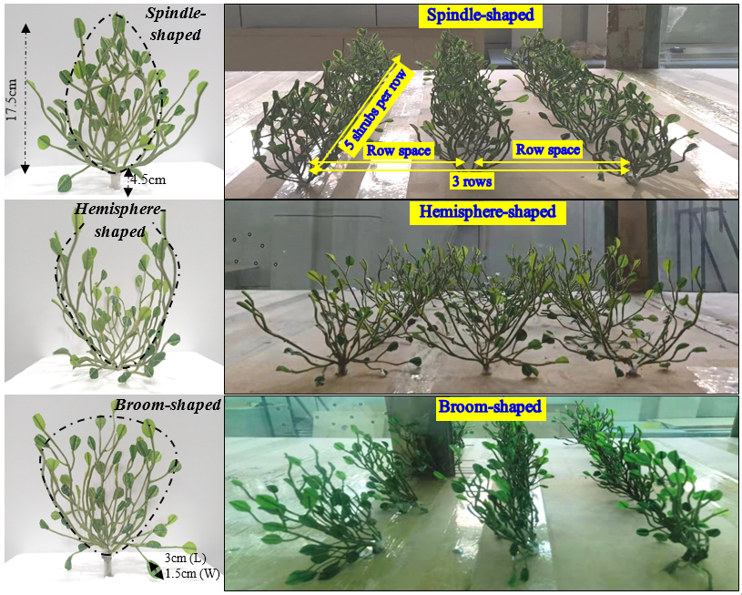
Variations in Airflow Field and Soil Grain-Size of Simulated Shrubs with Different Spatial Configurations based on Wind Tunnel Experiments
Xia Pan, Zhenyi Wang Department of Desert Control Science and Engineering, Inner Mongolia Agricultural University, China.
Introduction
Results and Analysis
Desertification is the main natural disaster in the arid and semiarid regions globally. It is a huge challenge to stabilize mobile sandy and control wind erosion. The establishment of simulated shrubs is expected to be one of the most effective measures to solve the above difficulties.
Fig.3 Distribution of the airflow field
Row Space:17.5 ×17.5 cm
Method - Wind Tunnel Experiment
The wind tunnel is 37.78 m long totally and the size of the test section is 16.23 m (Length) ×1 m (Width) ×0.6 m (Height).
A sand collector with 15-layer stepped was placed behind the last row of simulated shrubs about 50 cm.
Wind speeds of 8, 12, and 16 m/s at different heights were measured using Pitot tubes along the central axis.
Three spatial configurations of spindle-shaped, broom-shaped, and hemisphere-shaped shrubs were made.
Row Space:17.5 ×26.25 cm
Fig.1 The arrangement of simulated shrubs and instruments in the test section of the wind tunnel
Row Space:17.5 ×35 cm
The designed windbreaks with Nitraria tangutorum, which more effectively reduced the wind velocity among the windbreaks compared to behind the windbreaks.
The simulated shrubs were at a scale of 1:4 (simulated shrubs : Nitraria tangutorum). The geometric morphology and canopy porosity of simulated shrubs are the same as Nitraria tangutorum.
The simulated shrubs were at a scale of 1:4 (simulated shrubs : Nitraria tangutorum). The geometric morphology and canopy porosity of simulated shrubs are the same as Nitraria tangutorum.
Fig.4 Characteristics of sand deposition
Fig.2 Simulated shrubs with different spatial configurations (left) and fixed in the test section of the wind tunnel (right)
The sand deposition of simulated shrubs with different spatial configurations increased with the improvement of wind speeds. The average sand deposition of spindle-shaped simulated shrubs in 17.5×17.5 cm and broom-shaped simulated shrubs in 17.5×26.25 cm under different net wind speeds was the least.
Table 1 The morphological characteristics of the Nitraria tangutorum and simulated shrubs
Shrubs |  | Height (cm) | Canopy dimension (cm) | Canopy porosity (%) | Frontal area (m²)
Nitraria tangutorum |  | 89±11 | 70 (length) × 75 (width) | 42–64 | 0.055–0.074
Simulated shrubs | Hemisphere-shaped | 22 | 15 (length) × 17.5 (width) | 51 | 0.059
 | Spindle-shaped | 22 | 17.5 (length) × 15 (width) | 47 | 0.052
 | Broom-shaped | 22 | 16 (length) × 16 (width) | 55 | 0.062
Conclusion
In the wind control system, the hemisphere-shaped windbreaks should be applied as near-surface barriers, and the windbreaks of broom-shaped and spindle-shaped can be used as shelterbelts above the near-surface. Analytical findings offer theoretical guidelines on how to arrange the windbreak forests for preventing desertification in the most convenient and efficient ways.

