Slide 1
Impact of PTFE distribution on water transport in a gas diffusion layer of polymer electrolyte fuel cells
Dieter Froning¹, JunLiang Yu¹, Uwe Reimer¹, Steven Beale¹,
Werner LEhnert^{1,2,3}
¹Forschungszentrum Jülich GmbH, Institute of Electrochemical Process Engineering (IEK-3), Jülich, Germany
²Modeling in Electrochemical Process Engineering, RWTH Aachen University, Aachen, Germany
³JARA-HPC, Jülich, Germany
Interpore, May 8, 2019, Valencia, Spain
d.froning@fz-juelich.de
Institute of Electrochemical Process Engineering (IEK-3)

Slide 2
Overview
Motivation
Simulation setup
Results
Summary

Slide 3
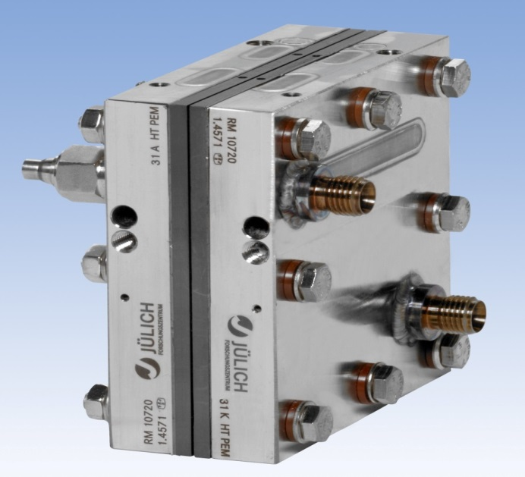
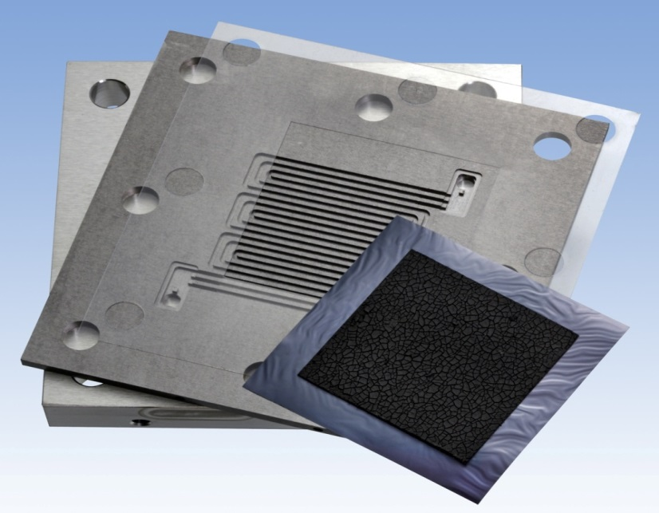


Polymer electrolyte fuel cell (PEFC)
Anode :
$$H_{2}→2H^{+}+2e^{−}$$
Active area: 4 cm x 4 cm = 16 cm²
Water management affects cell performance
Contact angles and breakthrough point distance can support two-phase CFD simulations in GC
$$\frac{1}{2}O_{2}+2H^{+}+2e^{−}→H_{2}O$$
Cathode :

Slide 4
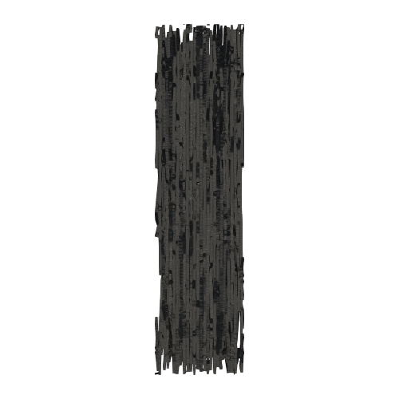
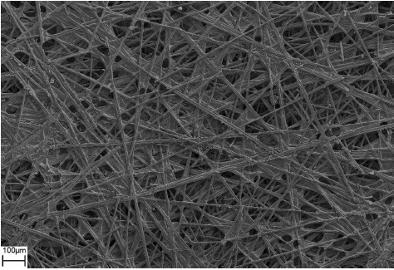
Stochastic Model of the GDL Structure
Ulm University
Assumptions on paper-type GDL
Fibers are horizontally oriented straight lines.
GDL can be separated into thin layers
Cells are partially filled with binder
22 realizations
2D SEM image of a GDL
3D model of a GDL
R. Thiedmann, F. Fleischer, Ch.Hartnig, W. Lehnert, V. Schmidt, Stochastic 3D Modeling of the GDL Structure in PEM Fuel Cells Based on Thin Section Detection, J. Electrochem. Soc. 155 (2008) B391-B399
4

Slide 5
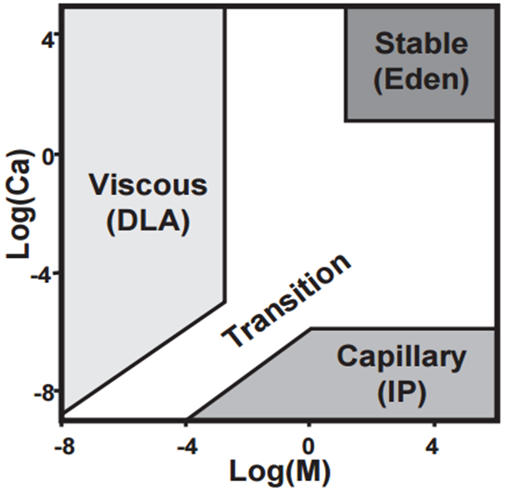
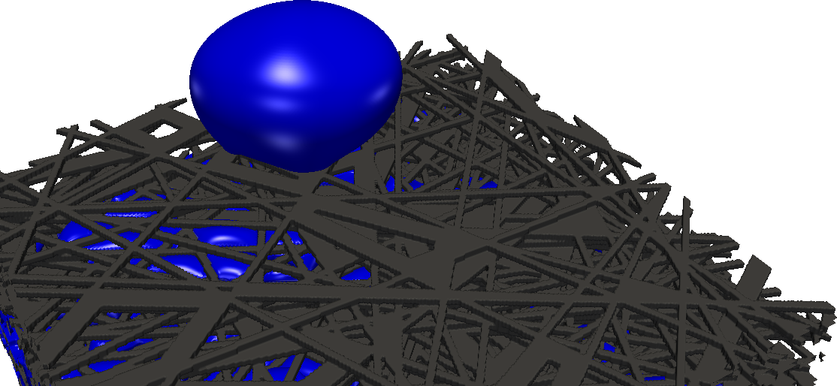
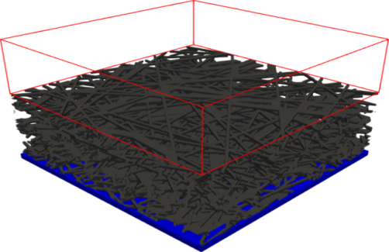
Simulation setup
Water flow through GDL is a capillary dominated process (density ratio and viscosity ratio can be negligible)
PEMFC working region
M≈18, Ca≈10⁻⁶~10⁻⁸ , average velocity used
Local contact angle: 110° (Water on PTFE)
Water velocity is defined with $Ca=\frac{μv}{σ}={10}^{−4}$.
Outlet : Open
Empty Space
Periodic
GDL
Inlet : Velocity

Slide 6
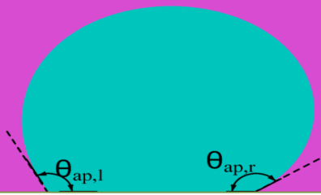
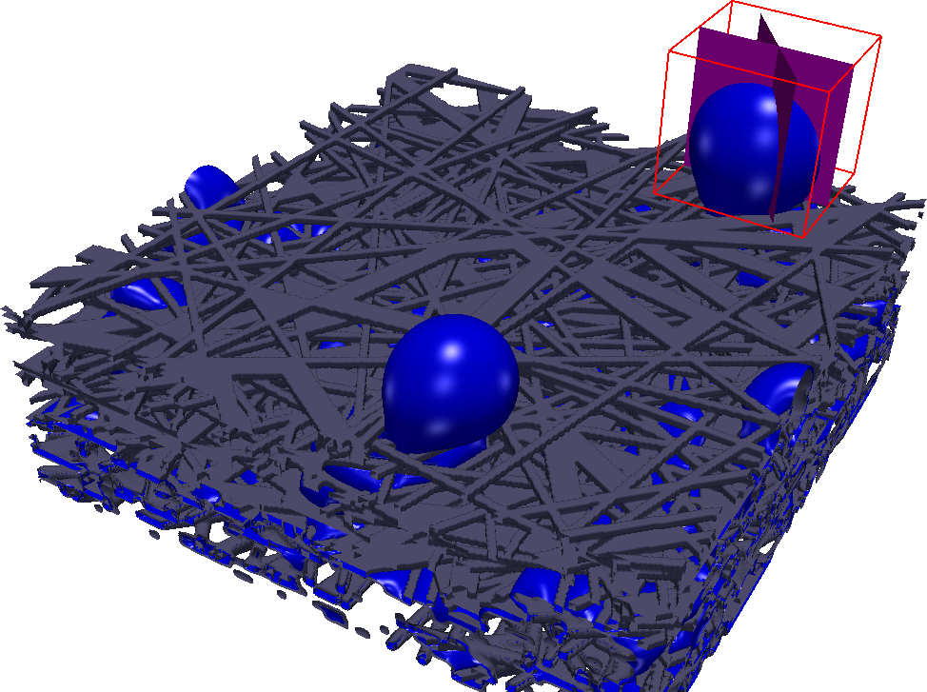
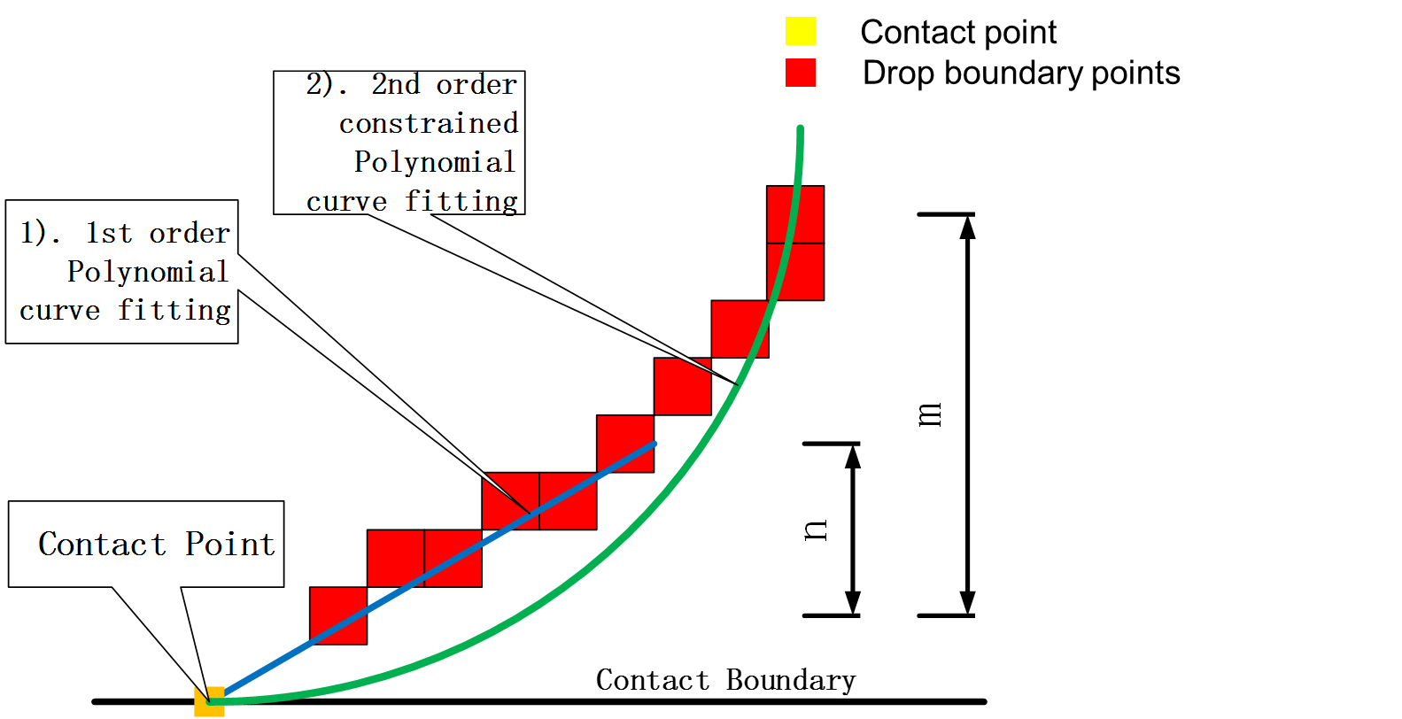
Apparent contact angle with the sub-pixel polynomial fitting method (SPPF)
Only the biggest droplet in every geometry is considered.
Only droplets not touching the boundary.
VA of cross sections: 90°, 60°, 30°, 0°
One of view angles ;
Asymmetric shape

Slide 7
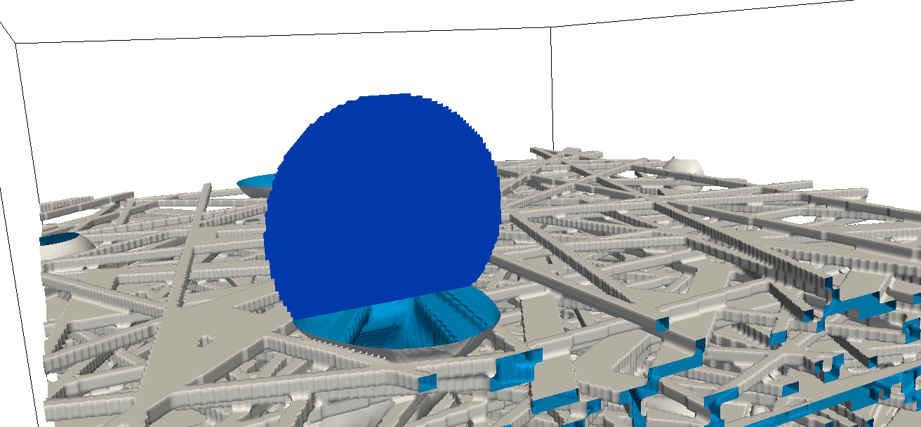
Apparent contact angle
Rotation of the view angle (VA)

Slide 8
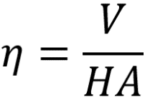
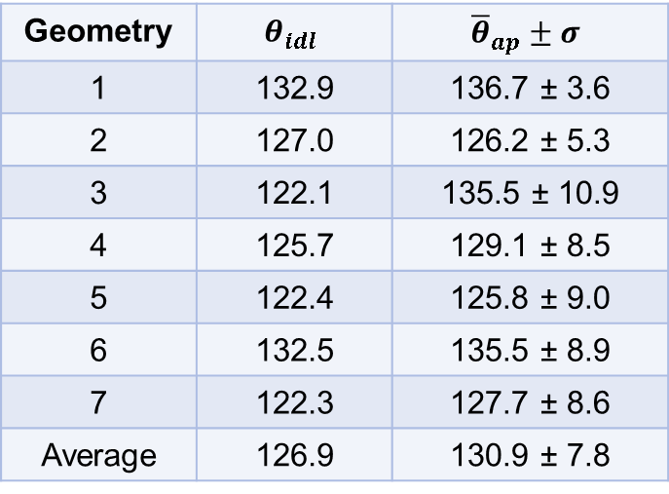
Comparison with idealized contact angles
V : Volume
H : Height
A : Contact area
Circle method
(symmetric drop) :
with
Geometry | $$θ_{idl}$$ | $${\overline{θ}}_{ap}±σ$$
1 | 132.9 | 136.7 ± 3.6
2 | 127.0 | 126.2 ± 5.3
3 | 122.1 | 135.5 ± 10.9
4 | 125.7 | 129.1 ± 8.5
5 | 122.4 | 125.8 ± 9.0
6 | 132.5 | 135.5 ± 8.9
7 | 122.3 | 127.7 ± 8.6
Average | 126.9 | 130.9 ± 7.8

Slide 9
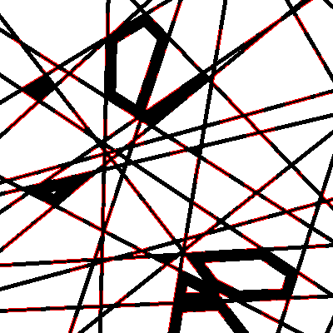
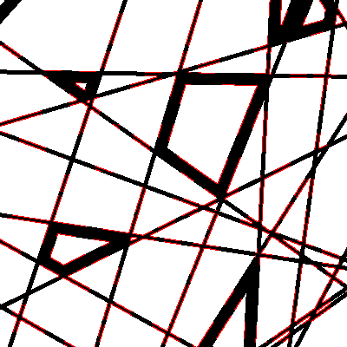
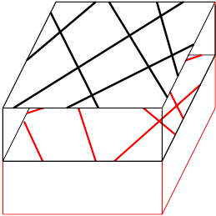
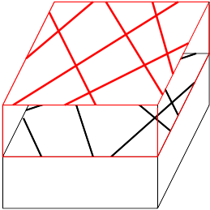
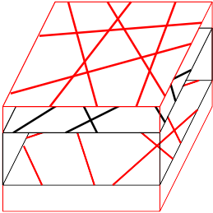
PTFE distribution
Randomly distributed, total PTFE coverage given
Regions with or without PTFE
Local contact angle Water/PTFE:
120° to pronounce the impact
50% PTFE, random. Two layers.
100% PTFE
0% PTFE
100% PTFE
0% PTFE
100% PTFE
0% PTFE
100% PTFE
Upstream.
Downstream.
Sandwiched.

Slide 10
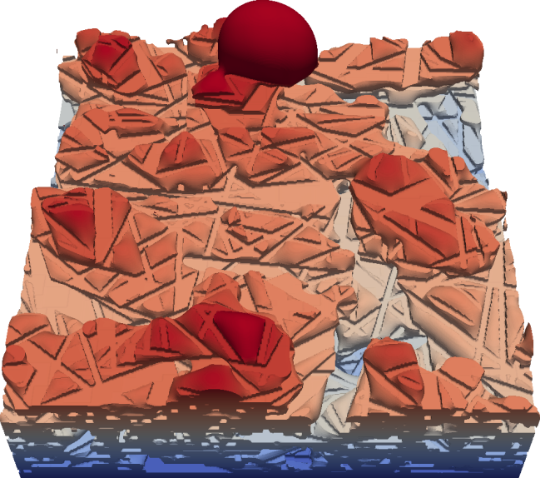
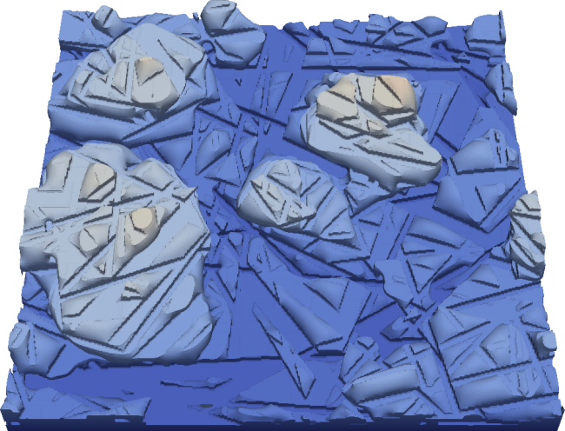
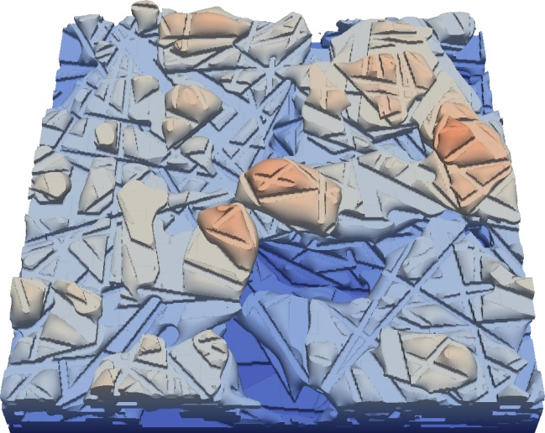
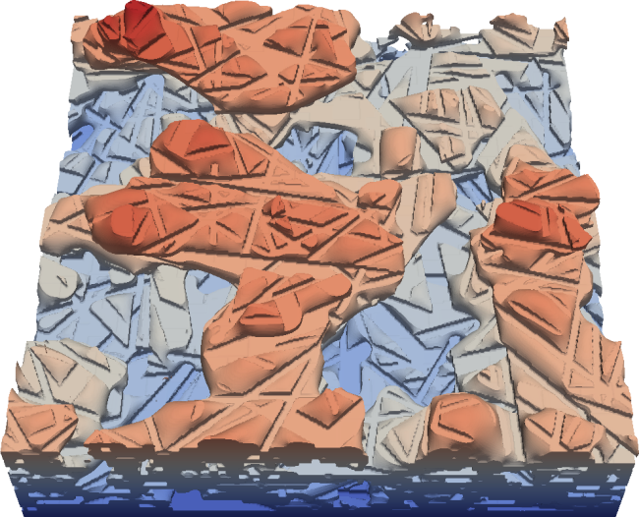
PTFE distribution
50% PTFE coverage, random distributed.
50% PTFE coverage, Upstream
50% PTFE coverage, Downstream.
50% PTFE coverage, sandwiched.
Through-pores available for gas transport.
4.8 ms
9.6 ms
14.4 ms
19.2 ms
Small through-pores in the GDL.

Slide 11
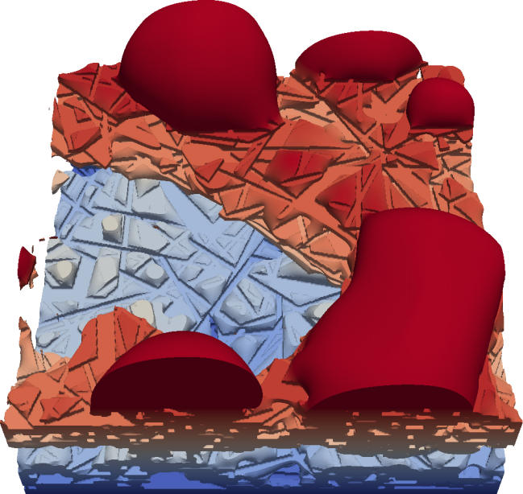
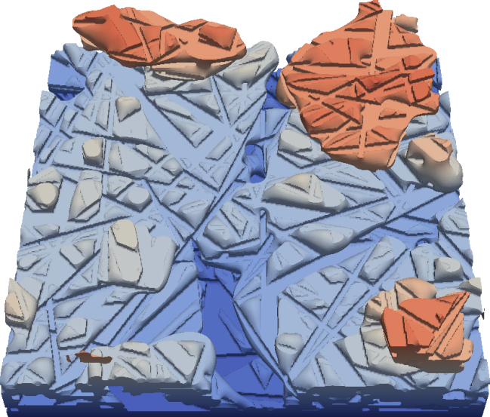
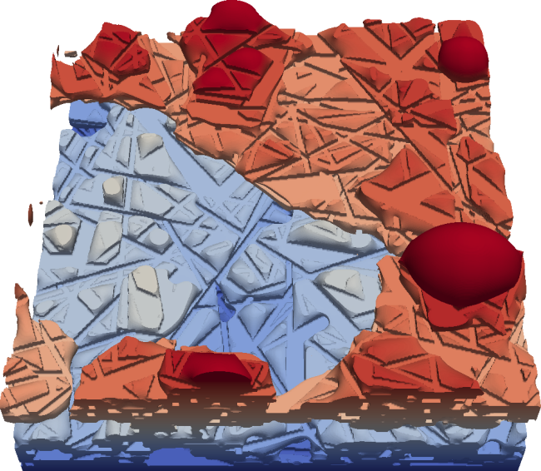
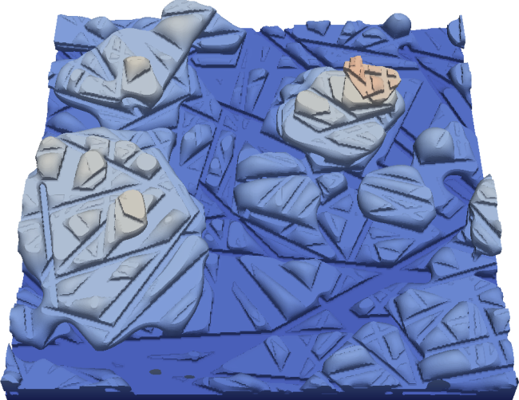
PTFE distribution
50% PTFE coverage, random distributed.
50% PTFE coverage, Upstream
50% PTFE coverage, Downstream.
50% PTFE coverage, sandwiched..
PTFE
4.8 ms
9.6 ms
14.4 ms
19.2 ms
Large through-pores in the GDL.

Slide 12
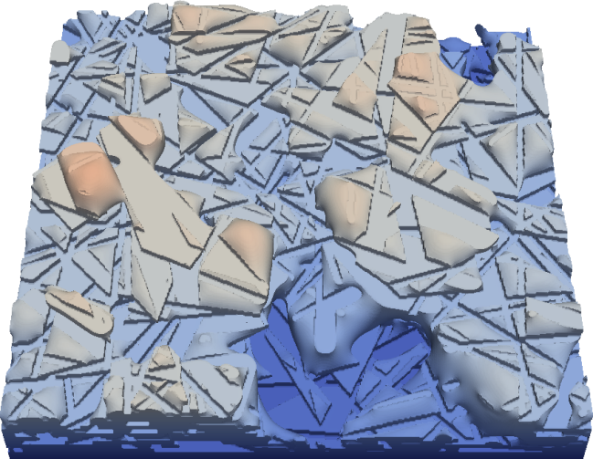
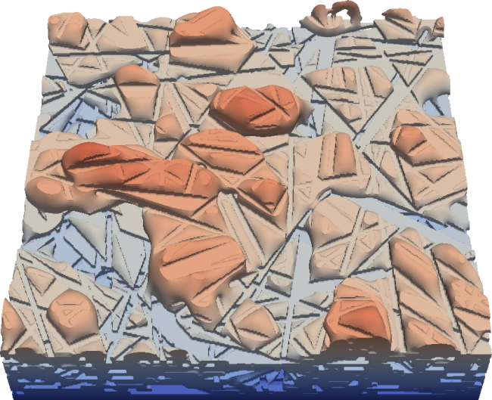
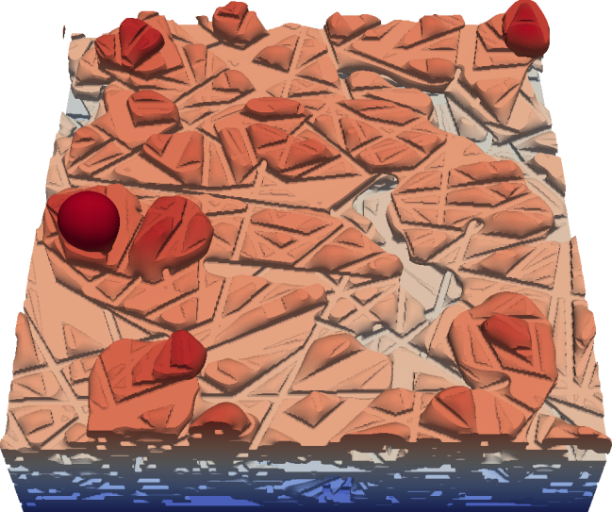
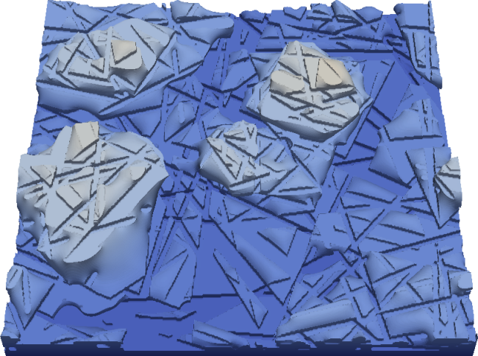
PTFE distribution
50% PTFE coverage, random distributed.
50% PTFE coverage, Upstream
50% PTFE coverage, Downstream.
50% PTFE coverage, sandwiched.
PTFE
4.8 ms
9.6 ms
14.4 ms
19.2 ms
No through-pores in the GDL.

Slide 13
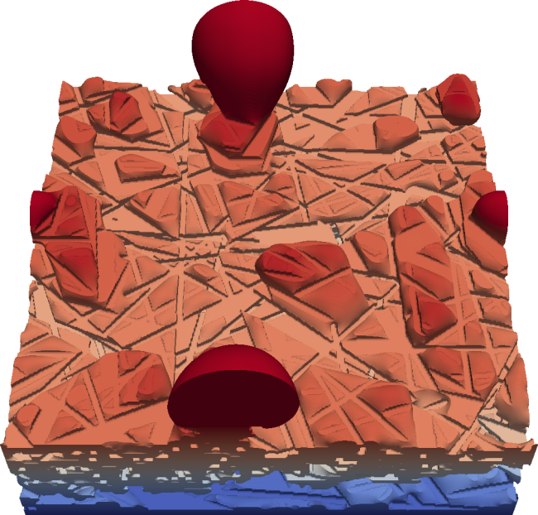
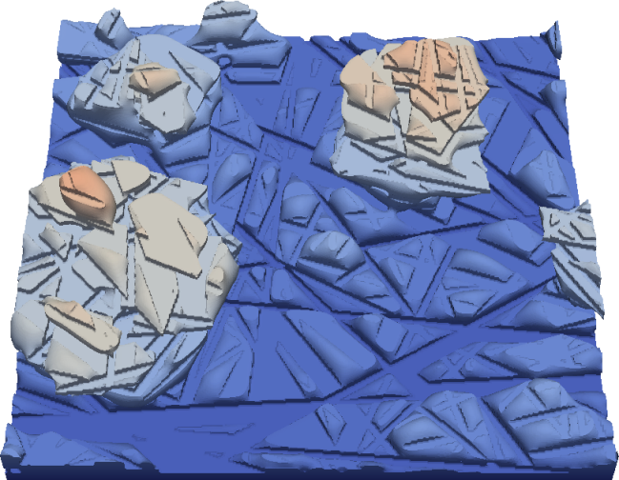
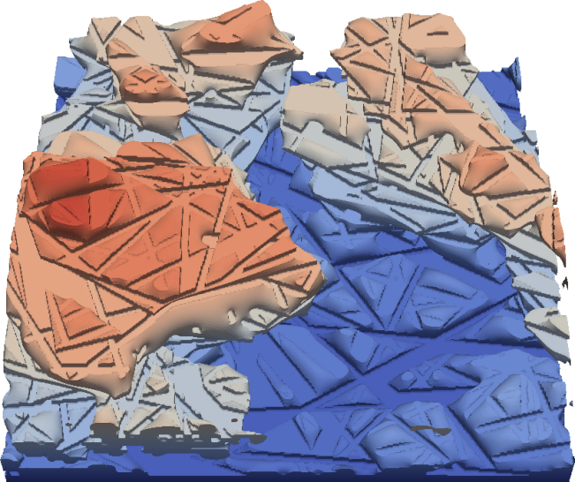
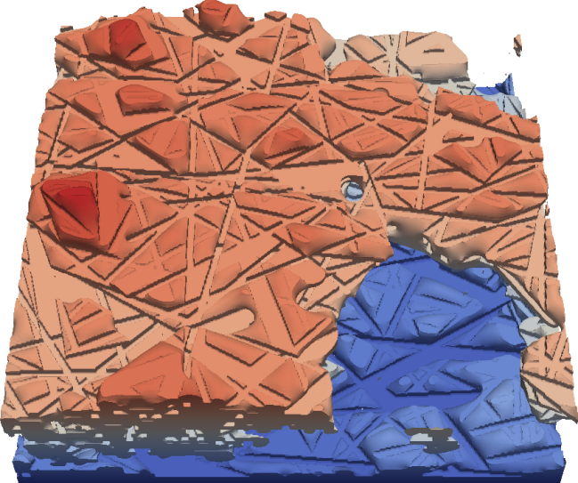
PTFE distribution
50% PTFE coverage, random distributed.
50% PTFE coverage, Upstream
50% PTFE coverage, Downstream.
50% PTFE coverage, sandwiched.
4.8 ms
9.6 ms
14.4 ms
19.2 ms
Large through-pores in the GDL – but they get closed.

Slide 14
Summary
Liquid water transport through GDL process are different in stochastic geometries and some droplets emerging on GDL surface
Droplet shapes are irregular and vary with different positions and geometries
Apparent contact angles are different from the idealized value and more accurate
Distribution of PTFE can induce additional effects.
PTFE is most effective in the upstream region of the GDL.
[1] J. Yu, D. Froning, U. Reimer, W. Lehnert, Apparent contact angles of liquid water droplet breaking through a gas diffusion layer of polymer electrolyte membrane fuel cell, Int. J. Hydrogen Energy, 43 (2018) 6318-30.
[2] J. Yu, D. Froning, U. Reimer, W. Lehnert, Liquid water breakthrough location distances on a gas diffusion layer of polymer electrolyte membrane fuel cell. J. Power Sources 389 (2018) 56-60.
[3] D. Froning, J. Yu, U. Reimer, W. Lehnert, Statistische Analyse des lokalen Wassertransportes einer Polymer-Elektrolyt-Brennstoffzelle. Chem. Ing. Tech., 91 (2019), https://doi.org/10.1002/cite.201800158.
[4] M. Andersson, S. B. Beale, D. Froning, J. Yu, W. Lehnert, Coupling of Lattice Boltzmann and Volume of Fluid Approaches to Study the Droplet Behavior at the Gas Diffusion Layer/Gas Channel Interface. ECS Trans. 86 (2018) 329-338.
[5] J. Yu, Lattice Boltzmann Simulations in Components of Polymer Electrolyte Fuel Cell, PhD thesis, RWTH Aachen University (2018), Aachen, Germany.
14

Slide 15
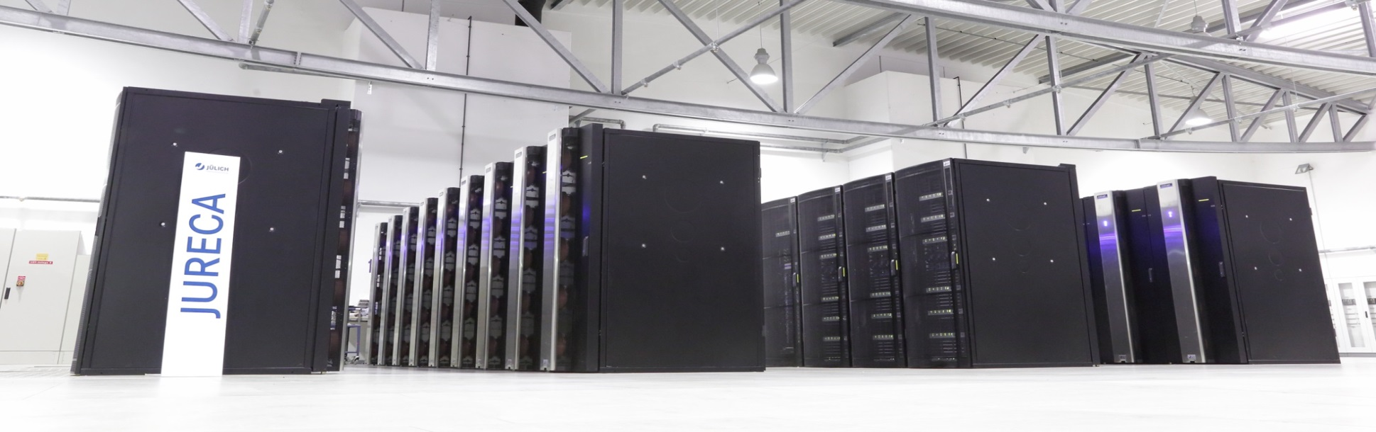
Thank you for your attention!

